Slide 1
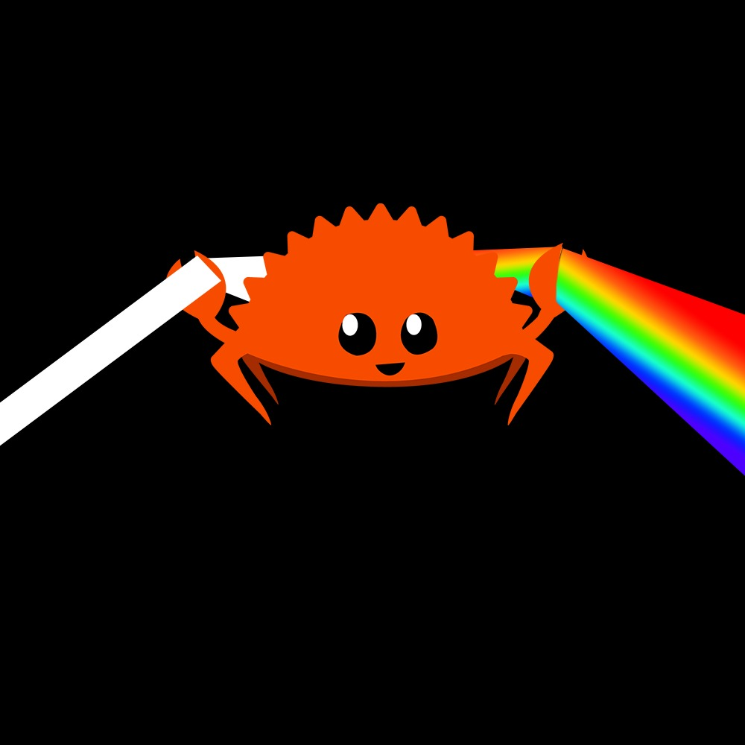
Rusterizer Masterclass “Hello Triangle!”
Luca Quartesan – quartesan.l@buas.nl – 03-10/02/2021

Slide 2
Welcome!
Feel free to ask questions at any point🙋
I will ask few questions too ⁉️
Learn Rust 🦀by making a software rasterizer
Math + Code = very nice
aspects of modern hardware rendering pipeline
Lecture 10-12, Lab 13-15
Lab with supervision feat. Embark and Traverse folks💿

Slide 3
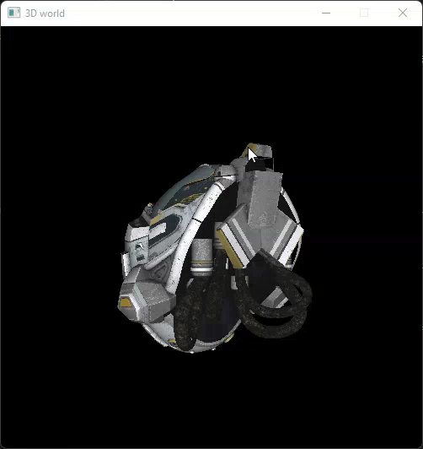
Welcome!

Slide 4
Agenda
Setup
Rasterization
Edge function
Colored triangle
Shading

Slide 5
Setup
Install Rust -> https://rustup.rs/
Install VSCode plug-ins
Rust-analyzer
Better TOML
crates
C/C++ (for debugger in vscode)

Slide 6
Rasterization
Rasterization vs Raytracing
object vs pixel centric
Project vs ray polygon intersection

Slide 7
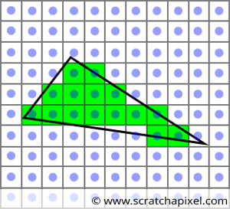
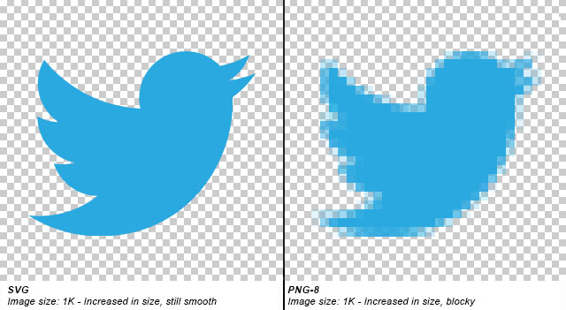
Rasterization
Rasterization vs Raytracing
object vs pixel centric
Triangle projection vs Ray intersection
Rasterization consists in generating a pixel representation from:
2D shapes (e.g vector graphics)
points
lines
splines
polygons

Slide 8
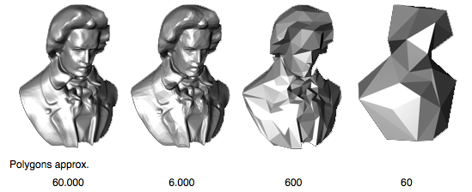
Why do we use triangles
Triangle is the simplest triangle
All polygons (convex and concaves) can be subdivided in triangles
For 3D objects we use a collection of triangles (Mesh) which defines the surface of the object.

Slide 9
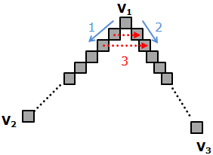
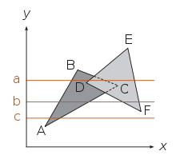
Rasterization algorithms
Which pixels should we fill?
Algorithms:
Scanline
Bresenham
Edge function
http://www.sunshine2k.de/coding/java/TriangleRasterization/TriangleRasterization.html

Slide 10
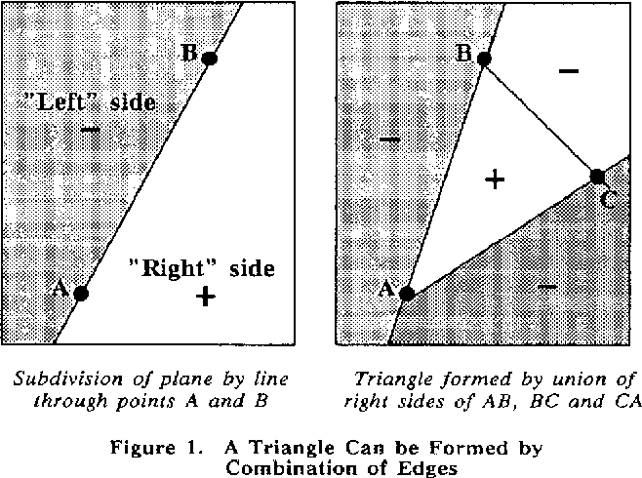
Edge Function
Pineda, J. (1988). A parallel algorithm for polygon rasterization.
given a line how can we determine on which side lays a point?

Slide 11
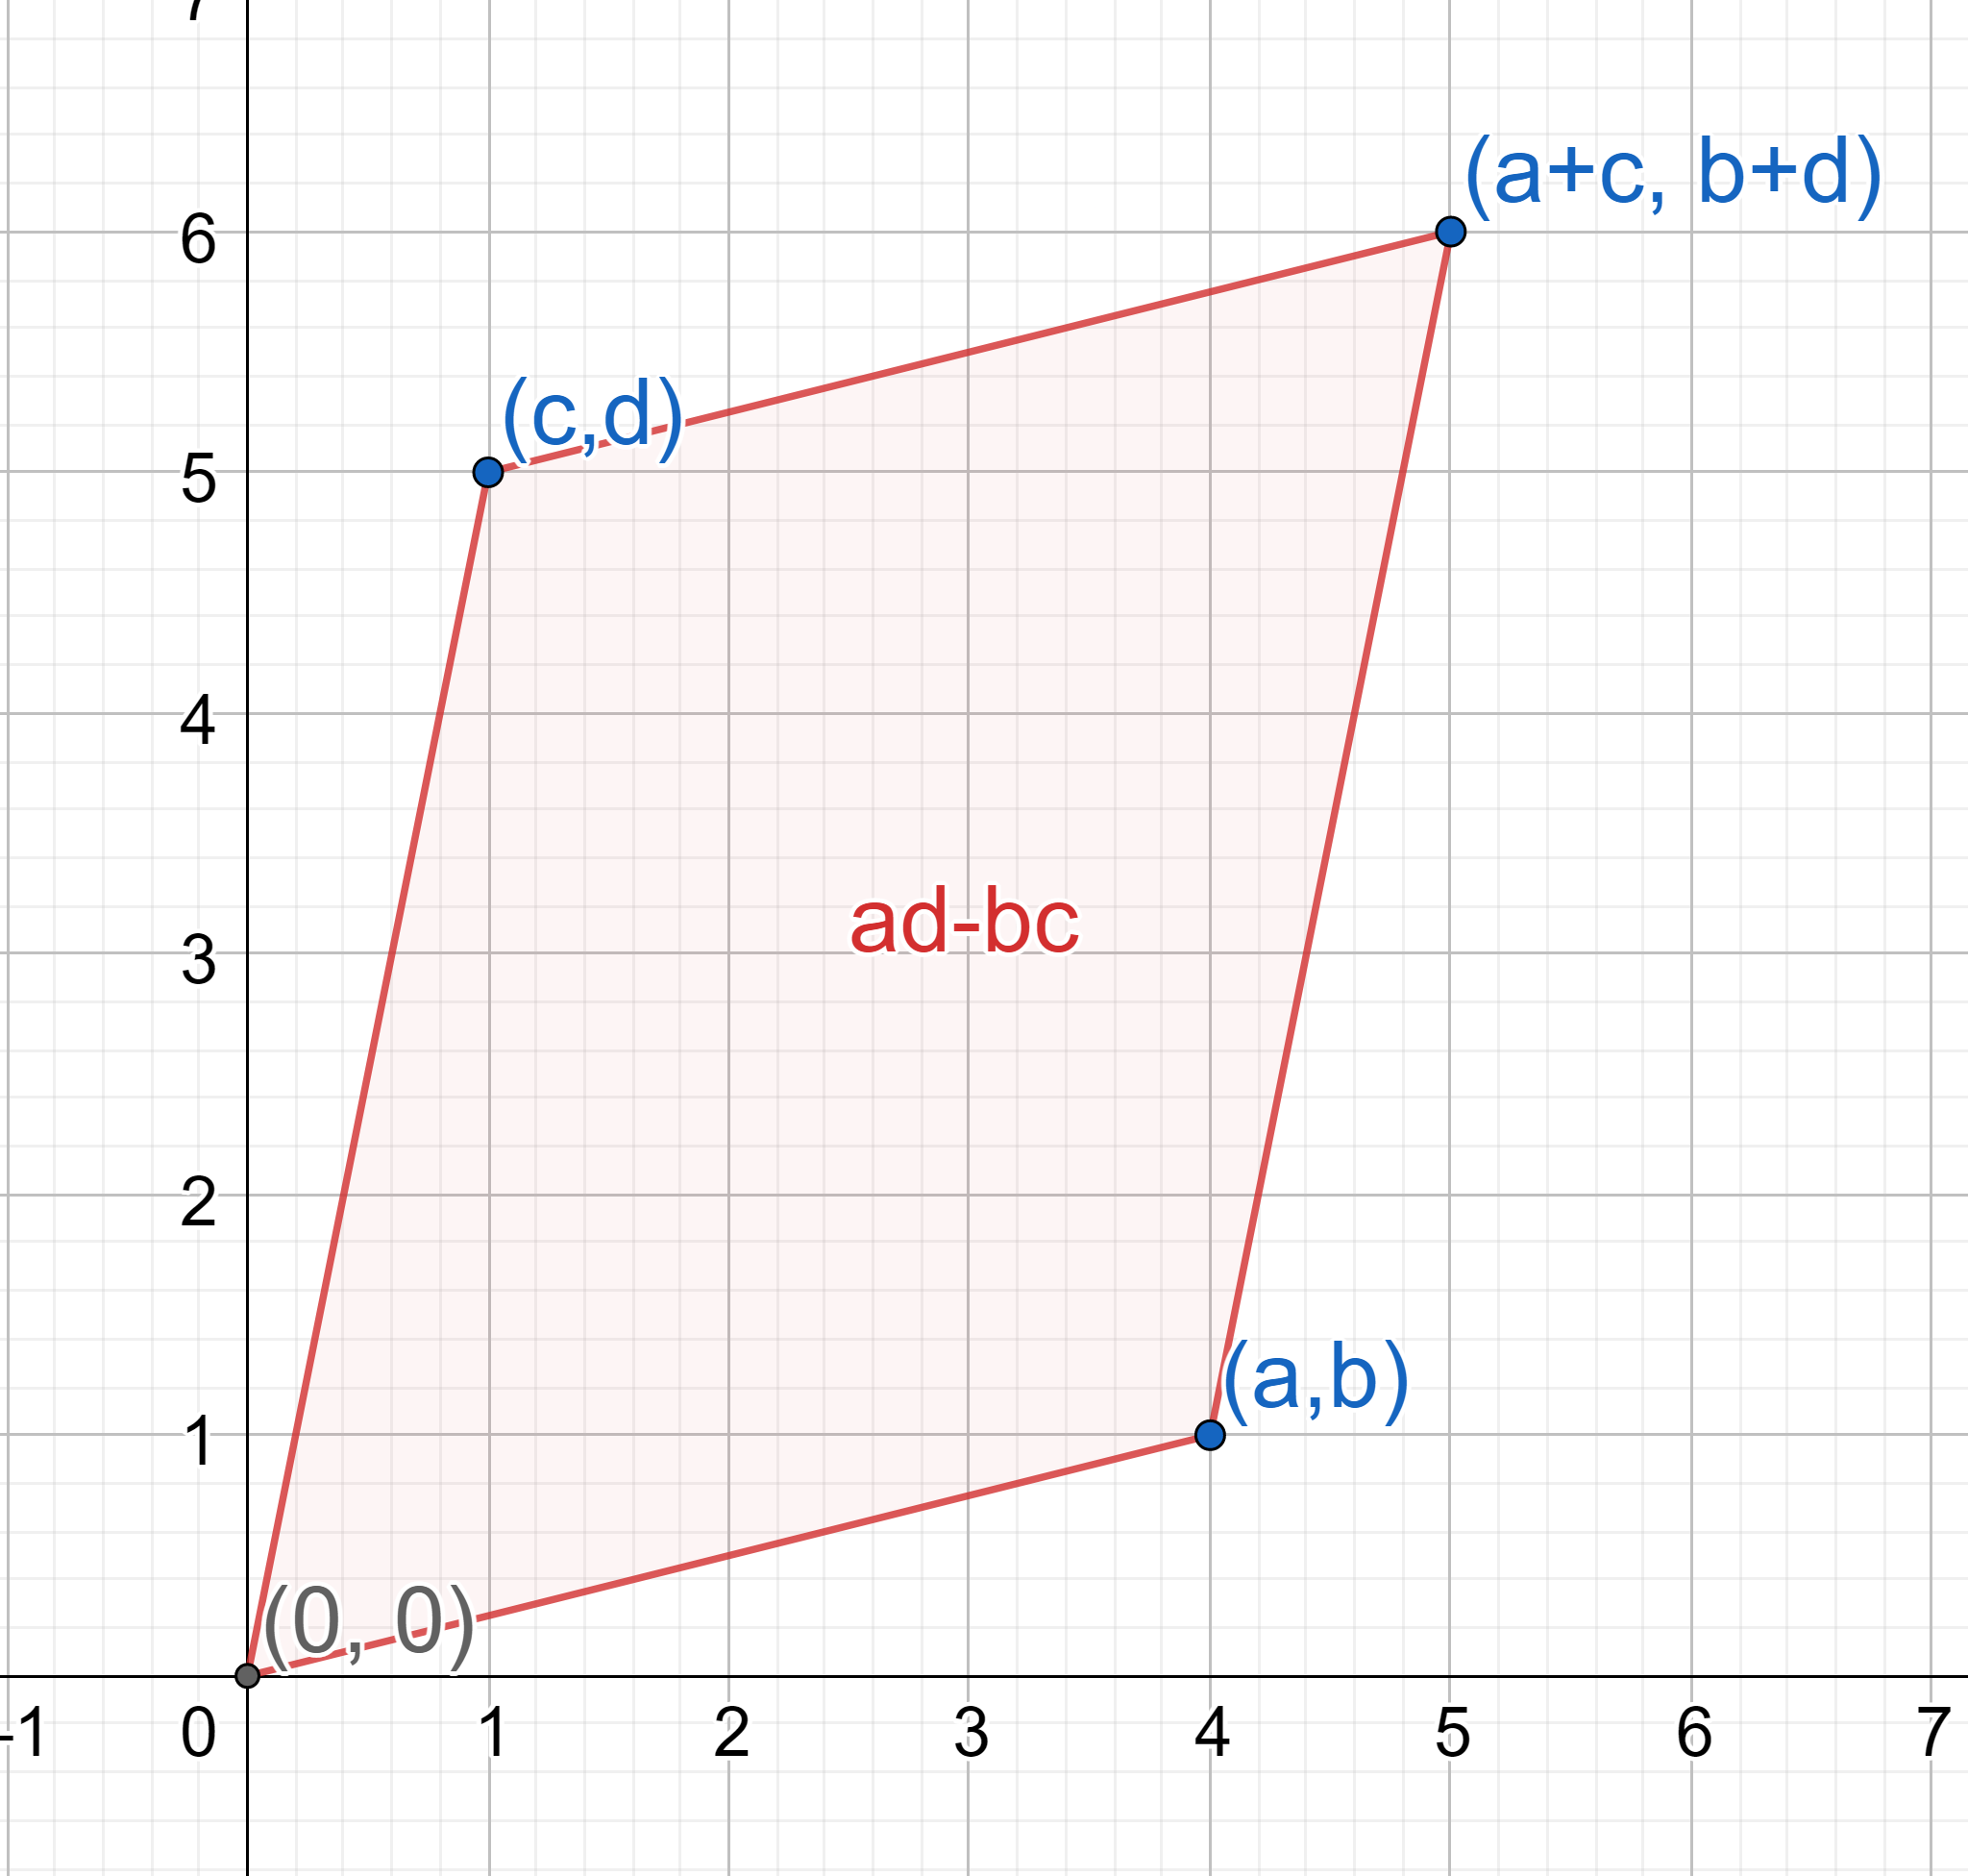
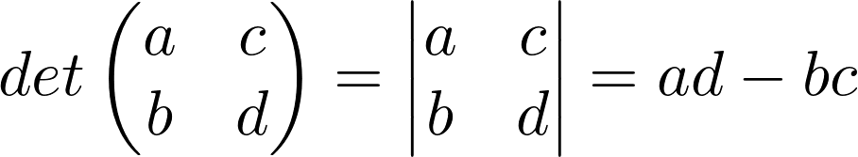
Edge Function
Determinant:
the determinant gives us the signed are of the parallelogram

Slide 12
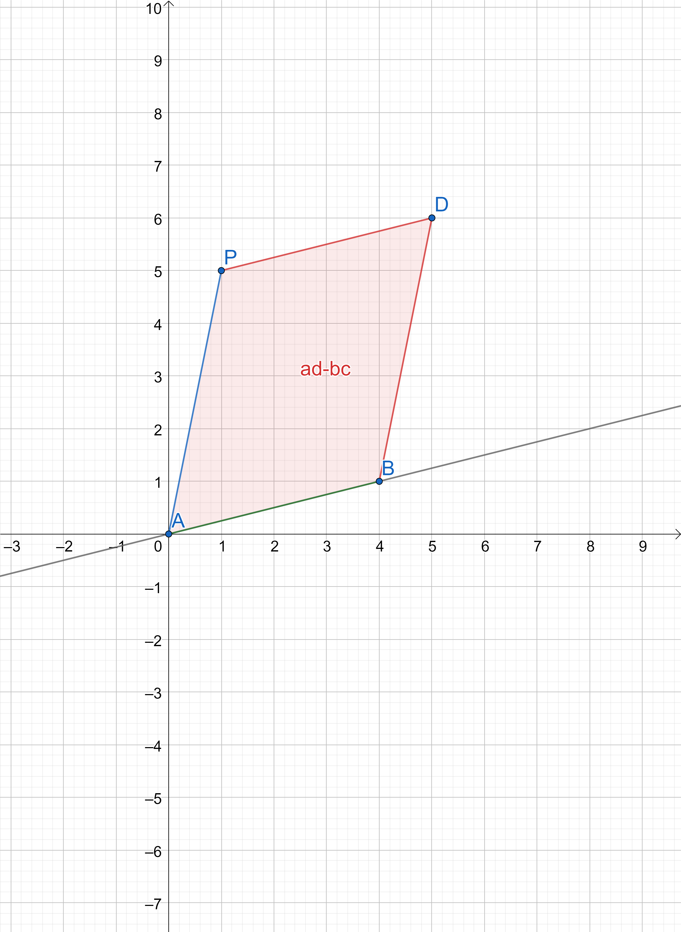
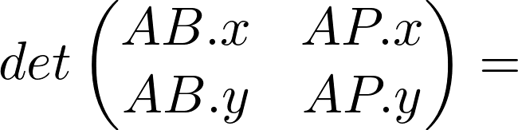
Edge Function
For a point P and a line passing by two points A and B

Slide 13
Edge Function
he signed area is negative when the angle from the first to the second vector turns in a clockwise direction

Slide 14
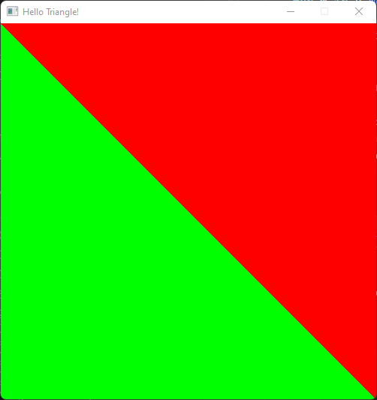
Edge Function
Does anyone know of another way of calculating on which side of a line a point lies?

Slide 15
Edge Function – cross product
can also be seen as determining the winding order
parallel with cross product
The magnitude of the cross product can be interpreted as the positive area of the parallelogram having AB and AP as sides
if the z-component of the cross product is negative, it lays on the negative side.
the z-component of this cross product is calculated as
Oh? Do I see a determinant here?

Slide 16
Edge function – Triangles
So now that we can determine on which side of line we are, how do we apply this to triangles?

Slide 17
Edge Function – Triangles
Pineda, J. (1988). A parallel algorithm for polygon rasterization.

Slide 18
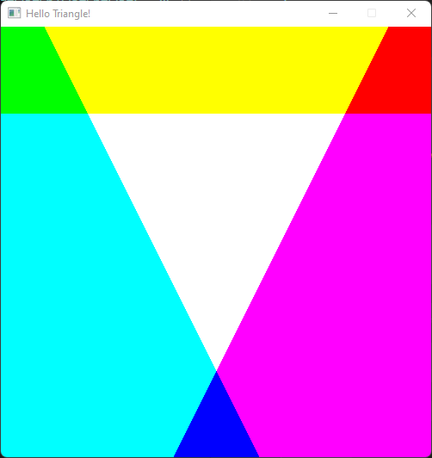
Edge Function – Triangles
A triangle has 3 edges => we need to compute 3 edge functions one per edge
If all positive then the point is inside the triangle

Slide 19
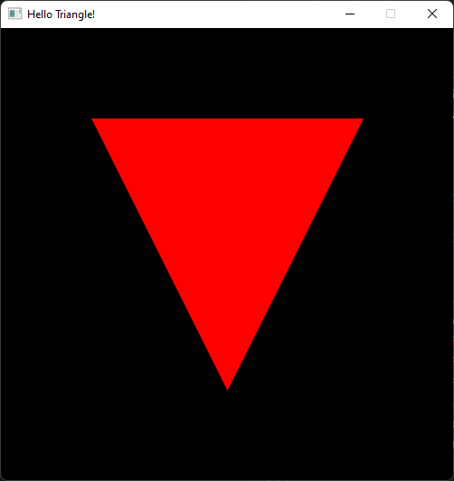
Thank you!
Many Question?

Slide 20
Resources
Rasterization: a Practical Implementation
Optimizing Software Occlusion Culling – index | The ryg blog
Texture Mapping & Polygon Rasterizing Tutorial (1/2) [C++20] – YouTube
3D Programming Fundamentals [Introduction] Tutorial 0 – YouTube
Rasterizer Algorithm Explanation - YouTube

